Slide 1

Narrative Shift Detection in News Media using Temporal Contrastive Learning

Slide 2
Objectives of the Work
01
Topic-Agnostic Narrative Shift Detection
Build a model that works across multiple unrelated topics (war, climate, health, economics, technology)
No need for topic-specific retraining or fine-tuning
02
Sentence-Level Shift Identification
Detect which specific sentences cause narrative shifts
Help users understand How exactly changed in the narrative

Slide 3

What is Narrative Shift?
A narrative shift is a change in how a topic is framed or interpreted over time
It reflects changes in meaning, not just factual content
Can occur even when the underlying topic remains the same
Represents evolution in perspective, emphasis, or context
Can be gradual (slow evolution) or abrupt (sudden change)
Shifts may be gradual — evolving incrementally as new information accumulates — or abrupt, triggered by sudden events.
The same topic can carry entirely different semantic framing across distinct time periods without any change in the underlying subject matter.
Detecting such shifts provides a systematic lens for understanding evolving media discourse at scale.

Slide 4
Real-World Example: COVID-19 Narrative Evolution
Early Coverage
1
Framing centered on origin and localized spread — treating the outbreak as a regional health concern.
2
Mid-Stage Coverage
Narrative shifted to a global crisis frame, emphasizing cross-border spread and overwhelmed healthcare systems.
Late-Stage Coverage
3
Focus transitioned to vaccination, recovery, and economic reopening — marking a clear interpretive transformation.

Slide 5
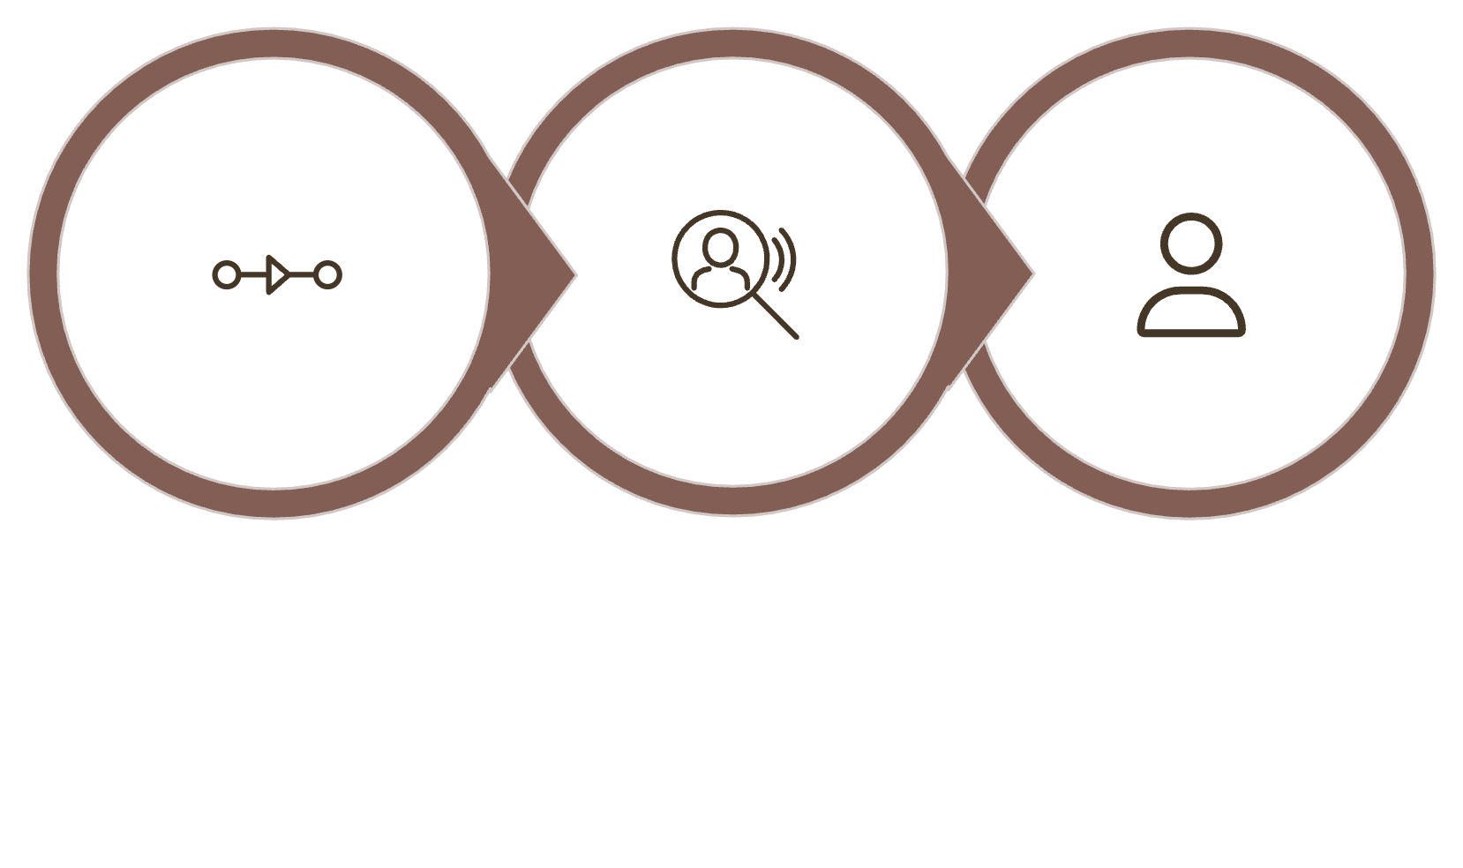
Problem Statement
Input
A chronologically ordered sequence of news articles spanning multiple time windows.
Output
Detection of when a shift occurred and the sentences responsible for the shift.
Temporal Input
Change Detection
Self supervised Output
Constraint
Fully unsupervised — no labeled data, predefined shift annotations, or domain-specific rules.

Slide 6
Data Description
01
Ideal articles
Created multiple articles that contain only the topic specific sentences, like war article only contain the war related sentences.
Used the sbert to find the overall embedding of the article that will help in the filtering out the topic specific sentence in the testing and training
02
Testing Data
With the help of LLM categories the article in 3 different categories, Hard, medium and low for each of the topic.
Each of these categories have 8 different article.
Hard categories means the set of article have the sentences in order ,where finding the narrative shift is very difficult.
Low categories means the set of article have the sentences in order, where finding the narrative shift is very easy.
Ground truth labels were manually annotated from the test data through human inspection of article narratives.
For each of the 5 topics there are 3 categories, and each categories have 8 article that lead to total 120 testing articles.

Slide 7
Data Sources for Training
1.17M
15
News Articles
Years Covered(2010-2025)
Collected from multiple sources spanning over a decade
Strong temporal coverage enabling longitudinal analysis
Collection Strategy
Articles were sourced from Kaggle datasets, public APIs, and web-based collections to maximize topical breadth and temporal range.

Slide 8
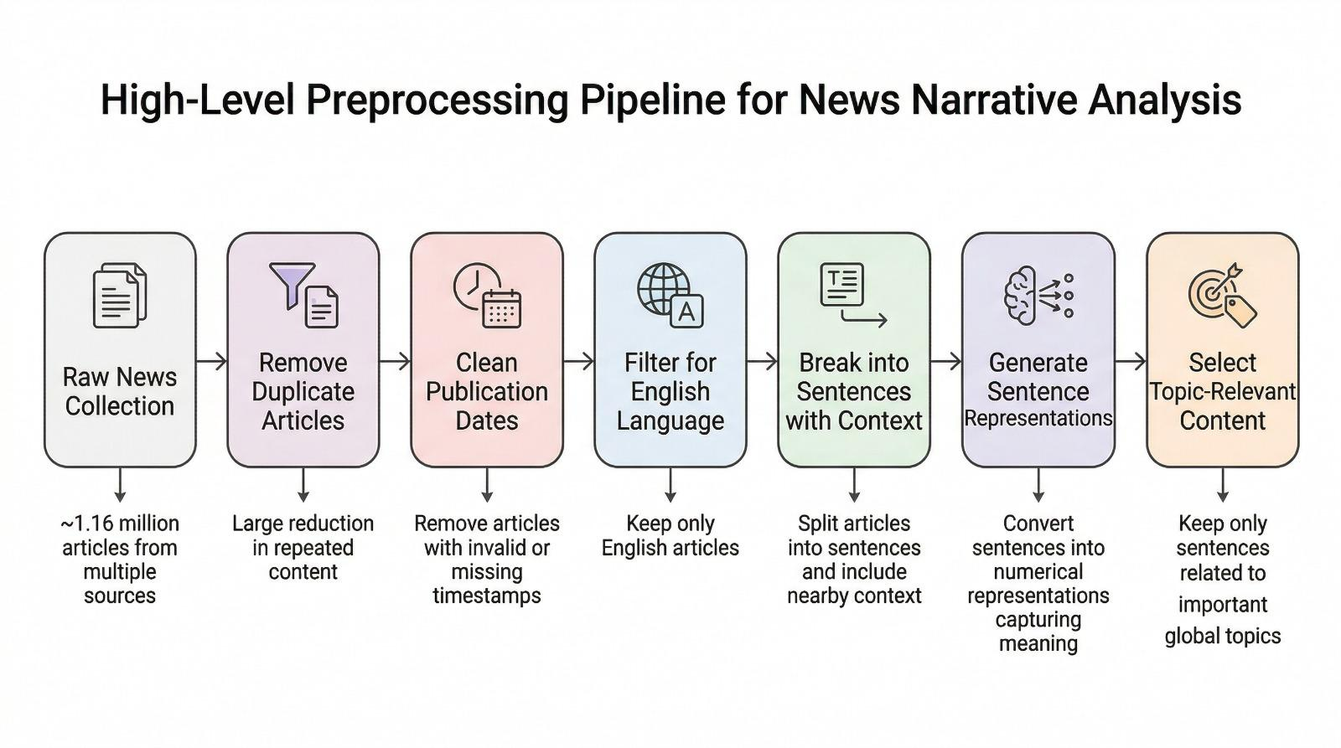
Data Cleaning & Preprocessing

Slide 9
K-Means Clustering Approach
Topic Specific Analysis
Each topic is analysed independently using filtered, topic-relevant sentences for precision drift detection.
Semantic Grouping
Sentence embeddings are grouped into K clusters (K=5), each representing a distinct semantic pattern or narrative theme.
Cluster as Structure
Each cluster acts as a proxy for narrative structure, with time windows represented as distributions over clusters.
Distribution Shifts
Narrative shifts are identified by changes in cluster membership over time, reflecting evolving narrative focus.

Slide 10
Limitations of K-Means Clustering Approach
Fixed Cluster Count
Only Consecutive Date Comparison
Measures Topic Shift, Not Narrative shift

Slide 11
SBERT Baseline Approach
Semantic Embeddings
Generates context-aware, dense vector representations (768-D) for each sentence, capturing semantic.
Contextual windows (e.g., w1, w3, w5) used to incorporate surrounding sentences, improving representation of narrative flow.
Similarity Measurement
Computed using cosine similarity between sentence or window embeddings, enabling comparison across time.
Changes in similarity reflect semantic drift, indicating how narrative meaning and framing evolve in embedding space.
Shift Detection
Detected by measuring embedding drift between consecutive time windows.
Significant divergence (above calibrated thresholds) indicates a potential shift in narrative framing or interpretation.

Slide 12
Limitations of SBERT
No Temporal Modeling
Limited Shift Detection Capability
Fixed Window Limitation

Slide 13
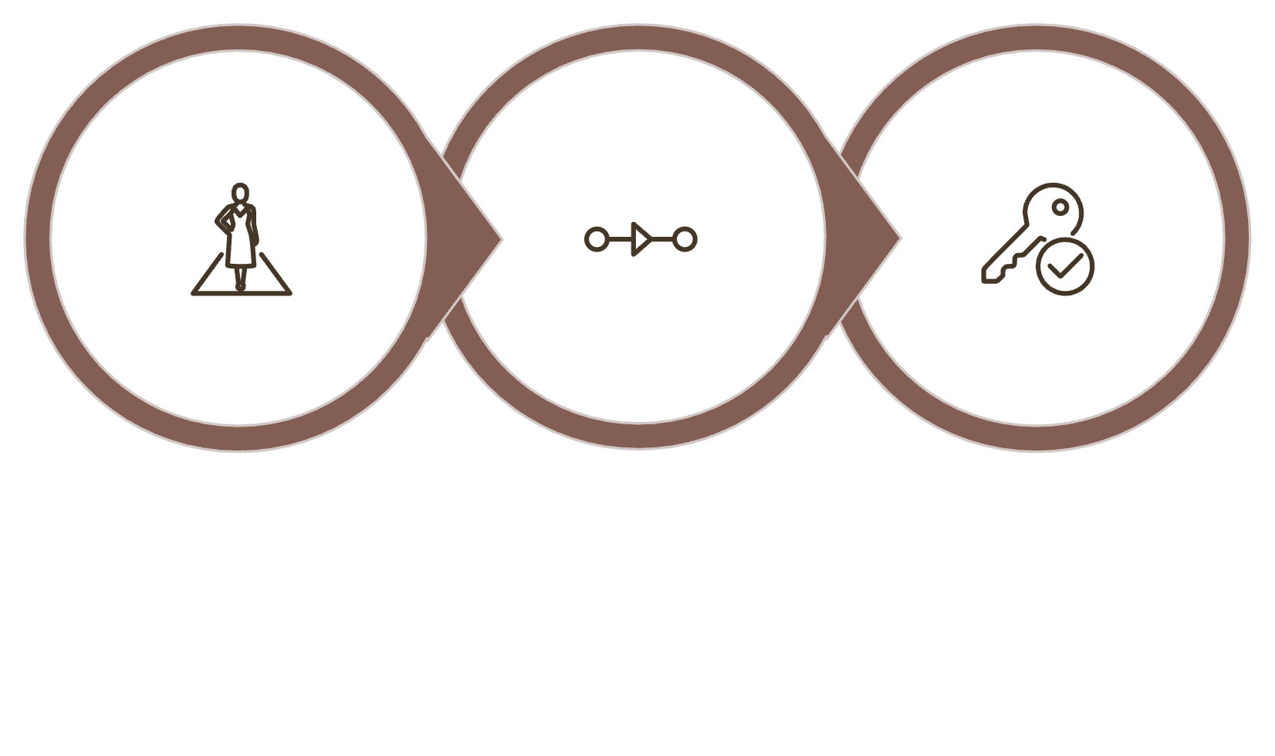
CORE INSIGHT
Narrative Shift Is a Temporal Problem
Static models fail at narrative shift detection as they treat language as a frozen snapshot, ignoring that meaning evolves over time.
Accurate shift detection requires modeling temporal relationships between segments—understanding not just what is said, but when and in relation to past context.
Temporal Relationships Matter
Static Models Fail
TCL Solves It
This critical gap motivates the adoption of Temporal Contrastive Learning as a more principled, time-aware framework.

Slide 14
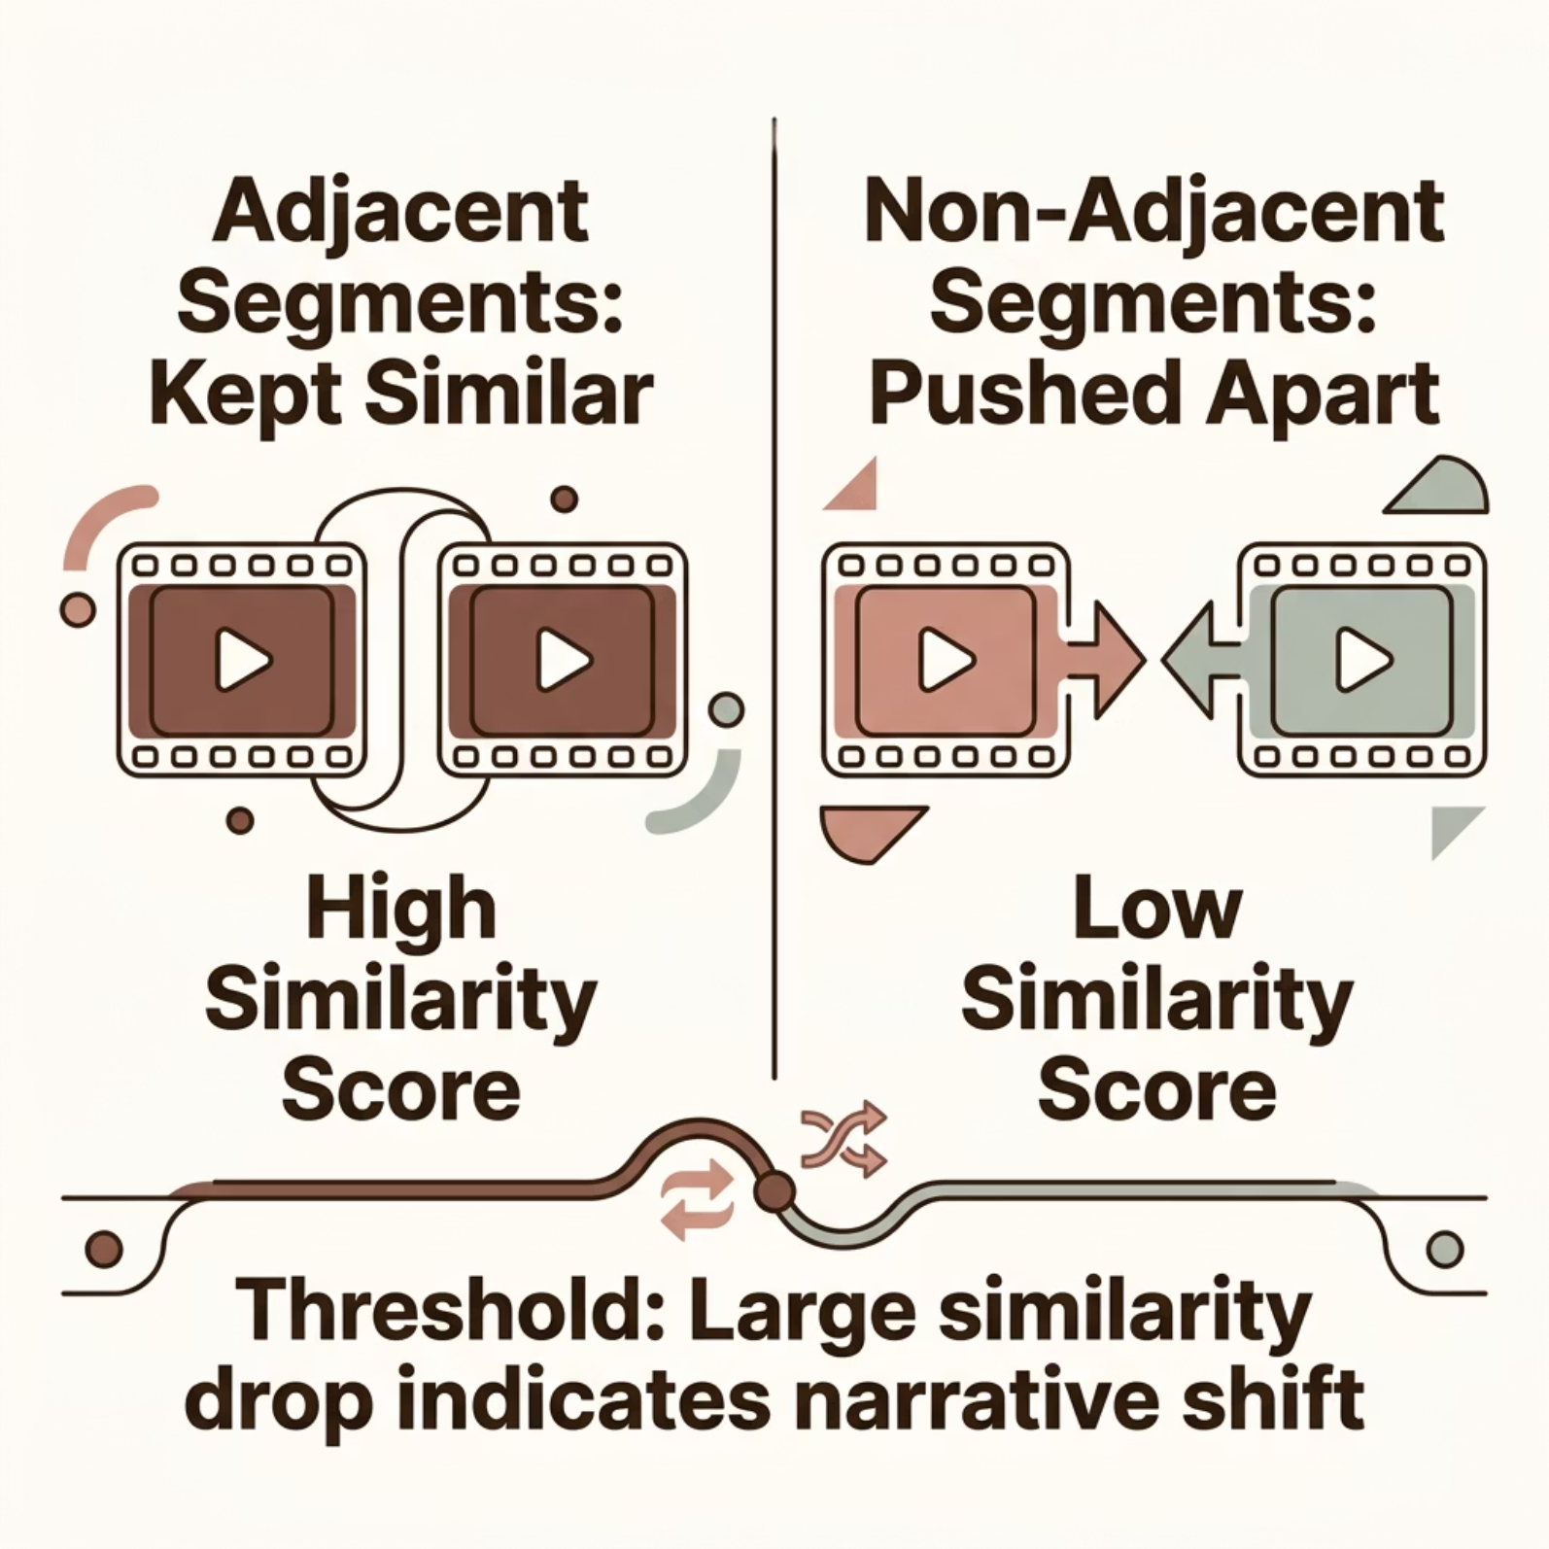

Temporal Loss Concept
How the Embedding Space Is Shaped?
The contrastive learning objective directly sculpts the geometry of the embedding space to reflect narrative structure.
Adjacent segments are penalized for drifting apart, ensuring the model learns smooth, meaningful continuity.
Non-adjacent segments are penalized for being too similar, preserving discriminative structure across the sequence.
A sudden drop in similarity between consecutive segments serves as the primary signal for narrative shift detection.

Slide 15

TCL Pipeline
A four-stage architecture that transforms raw sentences into temporally structured, shift-aware representations.
Transformer Proc
Contrastive Loss
SBERT Encode
Temporal Seg
Stage 1 — Encode
Stage 2 — Segment
Raw sentences are converted into dense embeddings using SBERT as the foundational encoder.
Embeddings are organized into ordered temporal windows that preserve sequential structure.
Stage 3 — Transform
Stage 4 — Learn
A transformer encoder processes each segment, integrating contextual information across the sequence.
Contrastive loss is applied to enforce temporal proximity and separation across the representation space.

Slide 16
Advantages of Temporal Contrastive Learning
Temporal Awareness
TCL models temporal relationships by learning from sequential segments, capturing both gradual evolution and abrupt narrative shifts instead of treating text as independent points.
Unsupervised by Design
The framework operates without labeled data using contrastive objectives, making it scalable and adaptable to large real-world news corpora.
Richer Structure
TCL learns a structured embedding space where related segments group together while distinct narratives are separated, producing more meaningful representations than SBERT or K-Means.
Accuracy & Interpretability
By combining temporal modeling with contrastive learning, TCL improves shift detection accuracy and provides interpretable outputs by identifying when shifts occur and key sentences.

Slide 17
APPROACH 1
Fixed Windows
Temporal Grouping
Shift Detection Mechanism
Sentences are grouped into fixed-size (overlapping/non-overlapping) windows to model temporal flow.
Narrative shifts are detected through similarity drops between consecutive windows, capturing continuity vs discontinuity.
Contrastive Learning (TCL)
Learns temporal relationships by treating adjacent windows as similar and non-adjacent as dissimilar using contrastive loss.

Slide 18
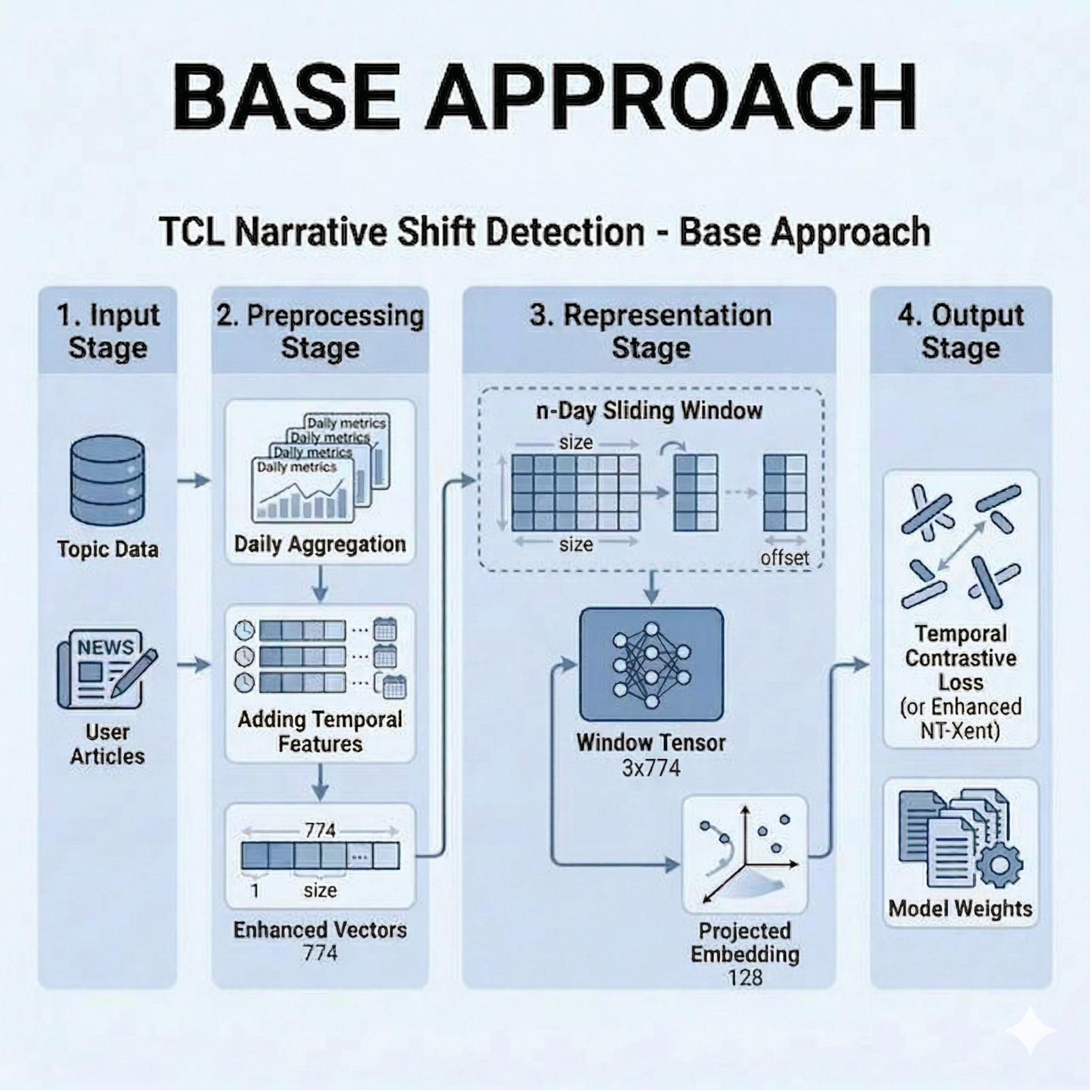
APPROACH 1
Fixed Windows

Slide 19
APPROACH 1
Limitations of Approach 1
Noise Sensitivity
Fixed Segmentation Issue
Small semantic variations distort representations, leading to unstable learning and inconsistent shift detection.
Fixed windows mix multiple narratives and fail to capture true semantic boundaries, reducing accuracy.
No Adaptive Speed
False Shift Detection
Fixed window size cannot adapt to different narrative speeds, causing misalignment with real narrative boundaries.
Lack of shared context causes noise or stylistic changes to be misinterpreted as real shifts.

Slide 20
APPROACH 2
Improvements in Approach 2 (Grouping Strategy)
Mean Pooling
Temporal Consistency
Sentences embeddings are aggregated using mean pooling to produce compact and smoother group-level representations.
Group-level embeddings preserve local continuity and better capture gradual narrative evolution.
Noise Dampening
Reliable Shift Detection
Grouping and mean pooling reduce noise and small variations, producing more stable representations.
Reduces false positives and improves stability of similarity-based shift signals.
Handling Data Sparsity
Robust to missing or uneven time gaps, maintaining continuity in real-world temporal data.

Slide 21
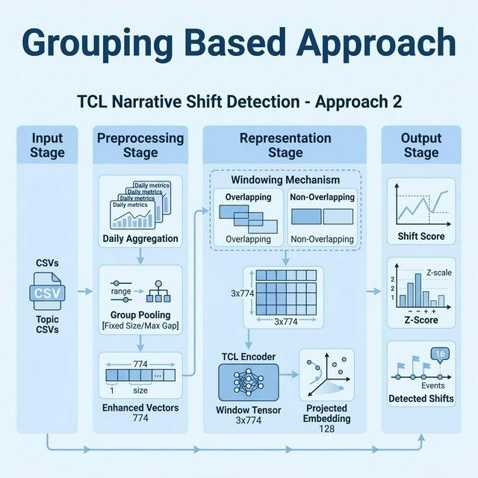
APPROACH 2
Approach 2

Slide 22
APPROACH 2
Limitations of Approach 2
Rule-Based Grouping
Static Logic
Relies on fixed heuristics instead of learned patterns, requiring manual tuning and limiting adaptability.
Same grouping rules across topics fail to adapt to different narrative speeds and domains.
No Semantic Awareness
Groups based on time proximity rather than meaning, which can hide true narrative boundaries.

Slide 23
APPROACH 3
Approach 3 (Analytics based)
Instead of using a one-size-fits-all topic’s window, we should discover the optimal window size for each topic by analyzing semantic drift patterns over historical data.
Why this not implemented?
Pipeline Complexity
Practical Limitations
Computational Cost
Adds extra steps for dynamic window adjustment
Increases implementation and debugging complexity
Hard to integrate into scalable, real-time systems
Not suitable for continuous monitoring pipelines
Requires repeated similarity calculations and iterative window refinement
Significantly increases processing time and resource usage

Slide 24
APPROACH 4
Dynamic Grouping
Semantic-Driven Boundaries
Robust to Noise
Segmentation is based on embedding similarity to detect true semantic changes instead of fixed heuristics.
Ignores minor fluctuations within segments and focuses on significant semantic transitions.
Fully Data-Driven
Robust Across Topics
Learns segmentation directly from data without manual rules, enabling better generalization across domains.
Generalizes well across diverse topics without requiring topics-specific tuning.
Adaptive Segments
Segment sizes adjust dynamically based on semantic continuity, capturing both gradual and abrupt changes.

Slide 25
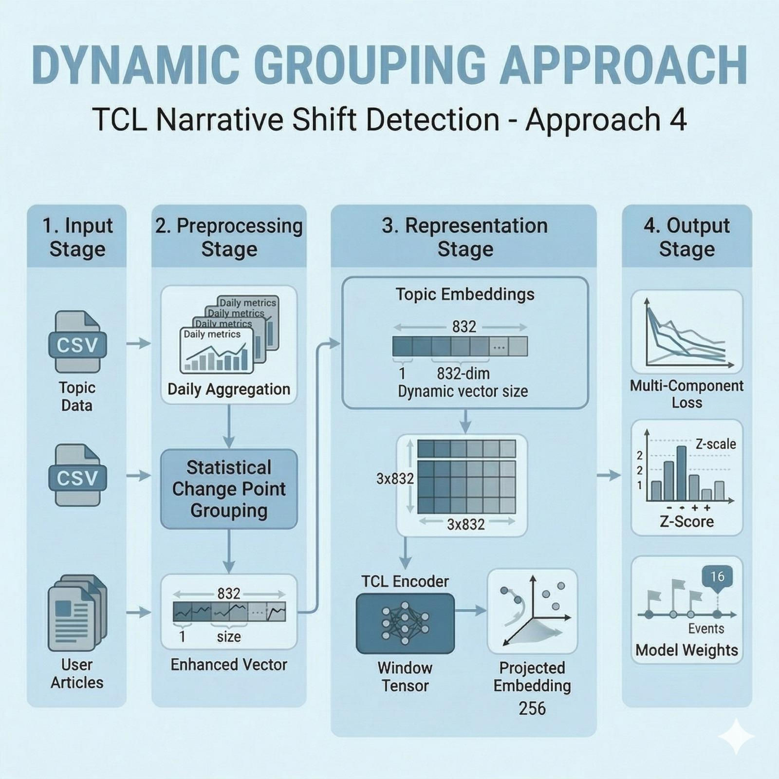
APPROACH 4
Semantic Segmentation

Slide 26
APPROACH 4
Limitation of Approach 4
Segment inconsistency
Hyperparameter sensitivity
Continuous narrative split due to topic fluctuation.
Performance depends heavily on penalty and model settings.
Cross-entity errors
Incorrectly mixes or splits different entities.

Slide 27
APPROACH 5
Entity Awareness
Named Entity Extraction (NER)
Improved Interpretability
Extracts key entities that act as semantic anchors, capturing important actors driving narrative changes.
Enables tracing which entities contribute to shifts, providing explainable insights into model decisions.
Entity-Aware Representation
Combines sentence embeddings with entity information to enhance contextual understanding and distinction.

Slide 28
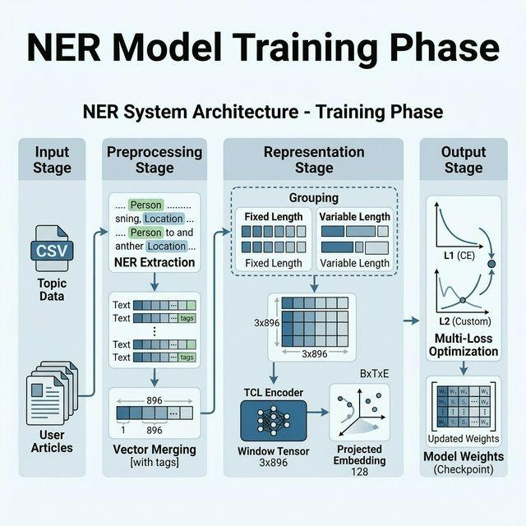
APPROACH 5
Entity Awareness

Slide 29
APPROACH 5
Limitations of Approach 5
Multi-Loss Balancing
Increased Computational Cost
Multiple loss functions create competing objectives, making weight tuning difficult and affecting overall performance.
Multi-loss training and NER processing increase computation time and reduce efficiency.
Training Instability
Dependency on NER Quality
Conflicting gradients from different losses lead to unstable training and convergence issues.
Performance depends on accurate entity extraction, and NER errors can propagate to final predictions.
Further Optimization Needed
Requires additional tuning and better integration of entity and semantic signals for optimal performance.

Slide 30
Results
Overall performance comparison across difficulty levels
Method | Hard F1 | Medium F1 | Low F1
SBERT | 0.100 | 0.130 | 0.060
K Clustering | 0.059 | 0.115 | 0.052
Approach 1 | 0.000 | 0.083 | 0.142
Approach 2 | 0.071 | 0.088 | 0.219
Approach 4 | 0.067 | 0.093 | 0.024
Approach 5 | 0.044 | 0.058 | 0.050

Slide 31
Key Observations
1
Temporal Modeling Is Essential
Capturing narrative evolution over time is crucial, as shifts occur gradually rather than in isolated sentences
Ignoring temporal order breaks context continuity and leads to weaker shift detection performance
2
Adaptive Segmentation Drives Gains
Adaptive segmentation aligns windows with real narrative boundaries instead of fixed intervals
Improves detection of meaningful transitions by adjusting to different narrative speeds
3
Static Models Are Insufficient
Static embeddings and fixed grouping fail to capture evolving narrative dynamics
Lack of temporal modeling leads to noisy signals and inaccurate shift detection

Slide 32
Case Study — Real-World Validation
Scenario: Conflict Narrative Tracking
Objective: Evaluate the model on real-world geopolitical news data to test its ability to detect meaningful narrative shifts.
Key Observations
The model successfully identified the transition from pre-conflict tension to active armed engagement as a clear narrative boundary.
It captured both abrupt shifts (e.g., sudden outbreak of conflict) and gradual changes (e.g., slow diplomatic deterioration).
Detected segment boundaries closely matched human-annotated ground truth, ensuring reliability.
Model output
“Senior officials described the move as a necessary step to weaken Moscow’s ability to sustain military operations, emphasizing that Washington stands firmly with Ukraine’s sovereignty.”
“Rising fuel and food prices are placing pressure on households worldwide, with economists warning of prolonged inflationary trends.”
“Healthcare challenges persist in war-affected areas, with limited access to essential medicines and services.”
“The crisis has also prompted renewed discussions on accelerating the transition to renewable energy sources.”
“While military aid continues, there is growing recognition that a negotiated settlement may be necessary.”
Key Outcome
The results demonstrate strong real-world applicability beyond controlled benchmarks.
Confirms that the model can effectively track evolving narratives in live, complex data environments.

Slide 33
Error Analysis on current testing
1
False Positives
Stylistic or tonal changes — such as shifts in journalistic framing or authorial voice — are sometimes misclassified as genuine narrative shifts, inflating detection counts.
2
False Negatives
When narrative transitions are gradual and subtle, the model may fail to cross the detection threshold, causing genuine shifts to go undetected.
3
Threshold Sensitivity
The choice of detection threshold significantly affects precision-recall trade-offs; no single value generalizes well across all topic types.

Slide 34
Future work / Proposal

Slide 35
Model Improvements
Embedding size : Sbert(768) , topic (5/ 64) , time (1), entity(64)
Now ,we have to come up with the embedding dimension that increase the representation of the topic , time and entity as compared ot sbert.
Multihead attention pooling : While current attention pooling learns a single importance distribution over tokens, multi-head attention pooling can model multiple complementary perspectives, leading to richer embeddings.
Contrastive Loss: We wanted to upgrade loss with temporal weighting to prioritize time-relevant relationships in narrative shifts.

Slide 36
Temporal Windowing
Currently we are using the fixed window for each of the topic, But each topic evolve at different rate.
Narrative evolution varies across topics—technology changes rapidly while domains like war evolve more gradually—thus, a fixed window is suboptimal, motivating topic-specific dynamic windowing.
“There are decades where nothing happens, and there are weeks where decades happen”
~ Vladimir lenin.
So it is not great idea to do the narrative shift based on the window, better to choose dynamic window, currently we are creating dynamic window only when there is semantic shift, but some time tone shift, weight to the topic and topic shift will also the factor responsible for the narrative shift

Slide 37
Entity aligned narrative shift
Building smarter models that understand entities
“The United States continues to provide military and financial support to Ukraine in its ongoing conflict with Russia.” “The United States is focusing on maintaining stability in the Indo-Pacific region to avoid escalating tensions with China.”
We aim to develop a more robust, entity-aware model that accurately captures narrative evolution within the same entity while minimizing cross-entity noise.

Slide 38
Thank You

